Slide 1

[Creating & Analyzing Open Data About Egypt]
February 2022
Final Presentation

Slide 2
Overview
Problem Statement
Project Objectives
Roadmap
Progress
Future Plans
Deliverables

Slide 3
Problem Statement
Collect, organise, and analyse different datasets directly about or related to Egypt. The results should serve as a starting point for anyone searching for datasets about Egypt. Providing dataset sources, visualisations, and reports that potentially use multiple datasets to tell a story with data. The results should also create a new dataset for Egypt and encourage the creation of more datasets by the community.

Slide 4
Project Objectives
Create a comprehensive index of open datasets about Egypt.
Integrate, analyze, and visualize diverse open datasets about Egypt.
Create a new dataset related to Egypt.
Host results on a website

Slide 5
Roadmap
Problem statement
Data Deployment
Data Collection
Web Visualisation

Slide 6
Data Collection
Data was scraped from Twitter, wikipedia,
news site.
Data was gotten from kaggle.
Scrapped Landmark data from Google images.
Presenter: Lilian Ugwu

Slide 7
Data Collection
Different domains data was gotten from:
Landmark
Accident and conflict
Literature
Economy
Politics
Environment
Food and beverages
Presenter: Lilian Ugwu

Slide 8
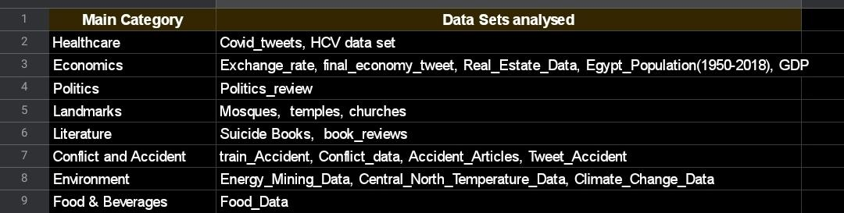
Data Collection
Domain and data set collected.
Presenter: Lilian Ugwu

Slide 9
Data Organization
Data has been collected and push into the repository
Data has been also arranged according to its respective category
Presenter: Lilian Ugwu

Slide 10
Data Organization
This is an initial outline: Dataset categories, descriptions, etc. can be decided on and edited later.
Data Organization
Datasets
Egypt Dataset Repositories
Climate and Other Geographical Datasets
Healthcare Datasets
Cultural and Linguistic Datasets
Population Datasets
Economic Datasets
Github link: giza-egypt-chapter-analysing-open-data/src/tasks/task_1_data_organization at main · OmdenaAI/giza-egypt-chapter-analysing-open-data (github.com)
Presenter: Lilian Ugwu

Slide 11
Data Visualisation
Showcasing the visualization and interpretation of the Egypt Datasets
Presenter: Armielyn Obinguar

Slide 12
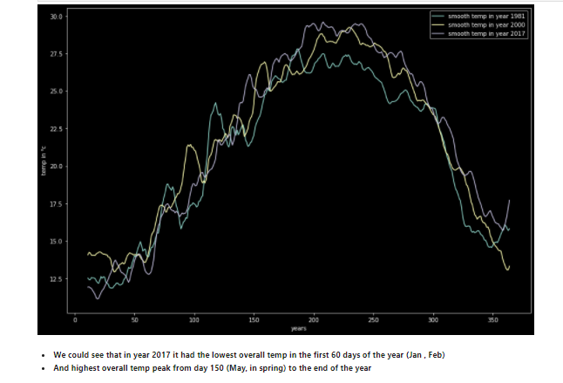
Data Visualization
Central_Eygpt_temperature_explotory_data_analysis_and_visualizaton
Collaborator: Hazem
Conclusion
We could see that how climate change in central egypt over the years
In winter the climate becomes colder than before
And summer gets hotter every year
Presenter: Armielyn Obinguar

Slide 13
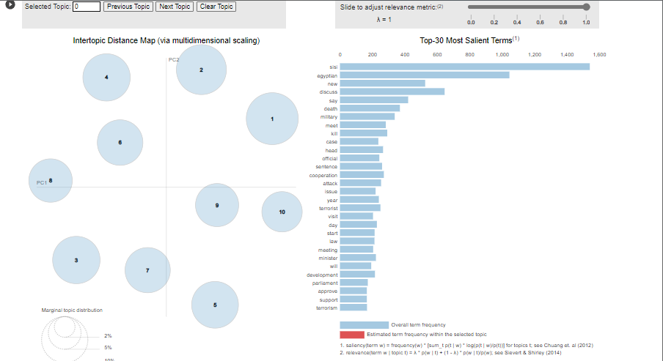
Data Visualization
LDA Topic Modelling for Political Reviews in Egypt
Collaborator: Armielyn
Interpretation: The events that had happened in Egpyt in terms of the politics such as the terrorism, bilateral talks, and other related issues which has been uncovered in this topic modelling.
Presenter: Armielyn Obinguar

Slide 14
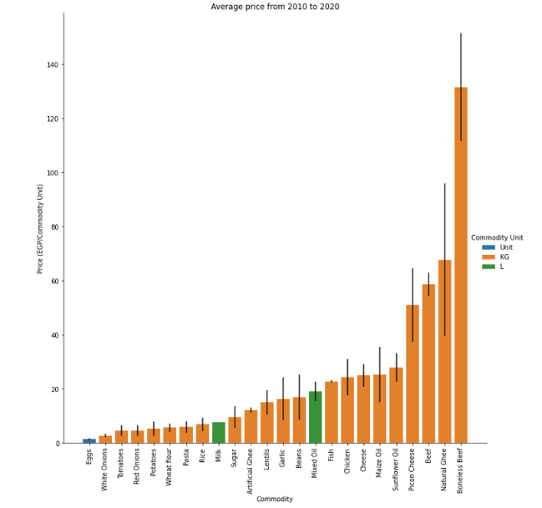
Data Visualization
Food Prices in Egypt (2010-2020)
Collaborator: Ahmed Khaled
Average Prices for each commodity along the period 2010-2020
Interpretation: Here, we can see that Beef, Ghee, and Oils were the products with the highest average prices. Cheese and Chicken are not so far behind
Presenter: Armielyn Obinguar

Slide 15
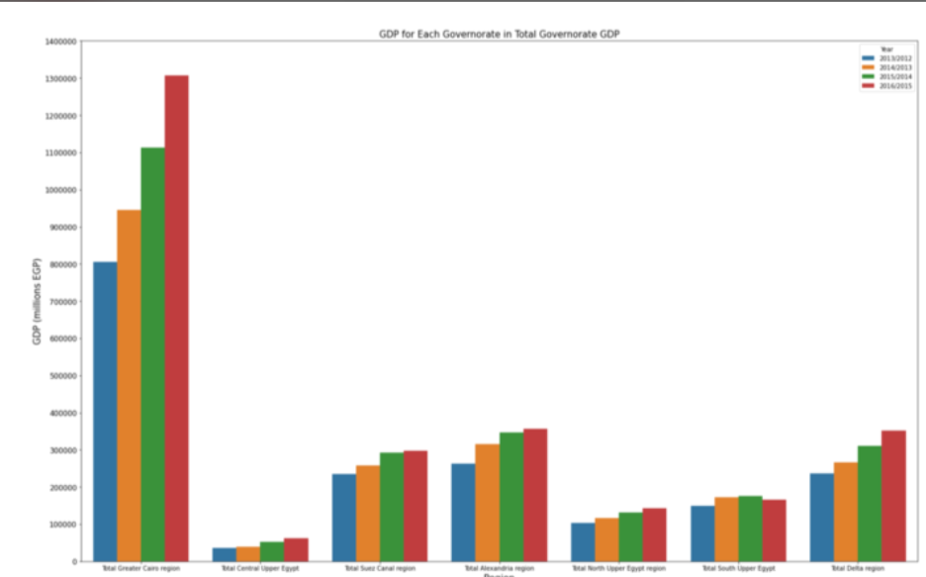
Data Visualization
GDP by Governorate 2012-2016
Collaborator: Ahmed Khaled
Visualization: Total GDP of each region in Egypt for each year.
Interpretation: Here we can see that the Great Cairo region contributes the most to the total GDP of Egypt and Central Upper Egypt contributes the least. We can also notice that the GDP of each region rose the following year except for the case of South Upper Egypt from 2014-2015 to 2015-2016.
Presenter: Armielyn Obinguar

Slide 16
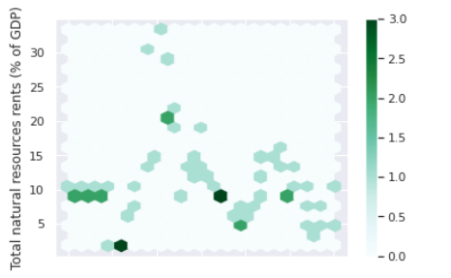
Data Visualization
Title: Egypt Energy
Collaborator: Abdulaziz Alamri
Visualization: Total natural resources rents (% of GDP)
Interpretation: We can see that Total natural resources rents across the majority of the years range from 5% to 20% of the GDP.
Presenter: Armielyn Obinguar

Slide 17
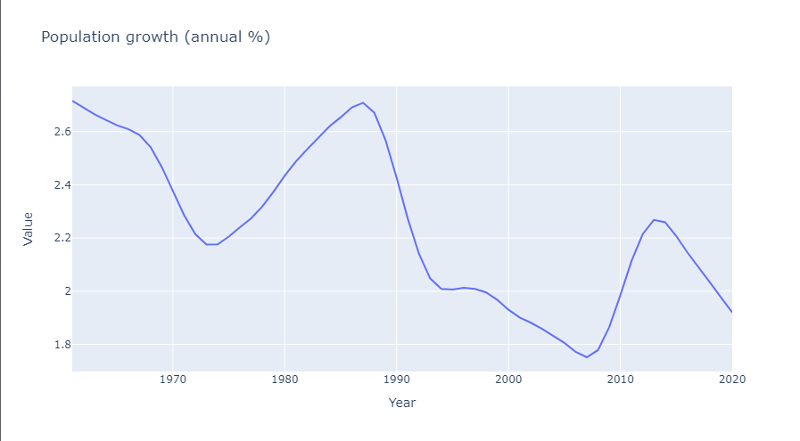
Data Visualization
Title: Egypt Population
Collaborator: Shivam Negi
Visualization: Population growth (% annual)
Interpretation: Though Egypt Population has increased from 26.6 million (1960) to 102.3 million (2020) , but the annual population growth has decreased from 2.7% to 1.9% (1960-2020)
Presenter: Armielyn Obinguar

Slide 18
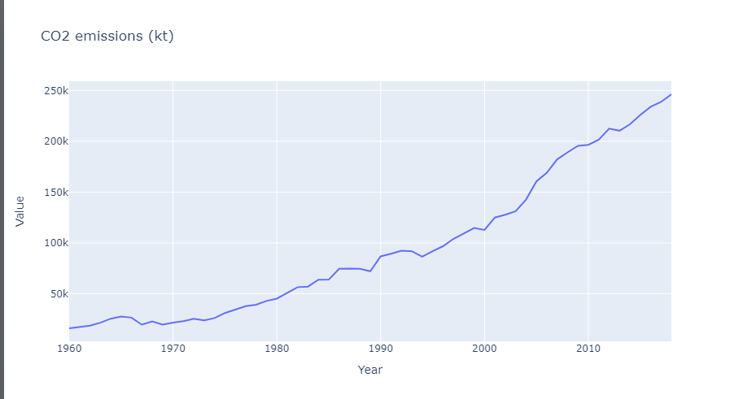
Data Visualization
Title: Egypt Climate Change
Collaborator: Shivam Negi
Visualization: CO2 emissions (kt) 1960-2018
Interpretation: CO2 emissions has gradually increased from 16 thousand kilo ton to 246.8 thousand kilo tonn from 1960 to 2018 respectively.
Presenter: Armielyn Obinguar

Slide 19
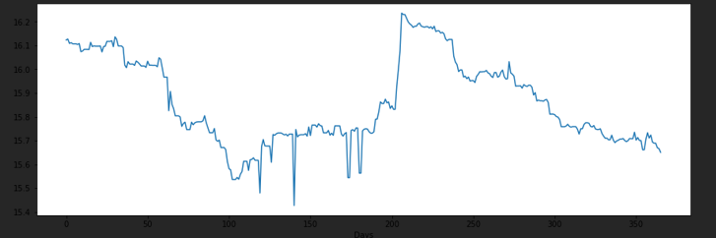
Data Visualization
Title: Egyptian Currency Price
Collaborator: Ahmed Samy
Interpretation: The price of the Egyptian pound compared to the dollar during 2020
Note: Here you can distinguish the abnormal stability in the price of the Egyptian pound in recent years... This is an indication that the state is interfering by injecting funds to control the price of the pound against the dollar.
Presenter: Armielyn Obinguar

Slide 20
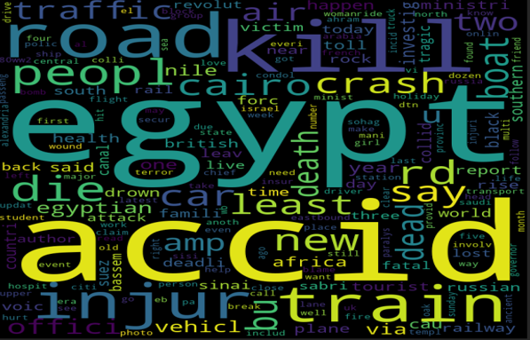
Data Visualization
Title: Egypt’s Accidents
Collaborator: Ahmed Samy
Interpretation:WordCloud of the most repeated words on twitter about this topic
Presenter: Armielyn Obinguar

Slide 21
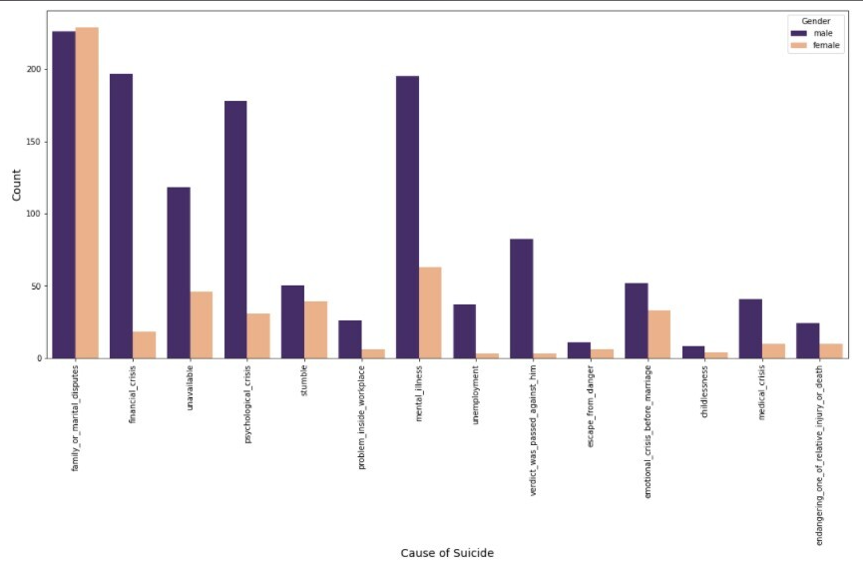
Data Visualization
Title: Suicides in Egypt
Collaborator: Michael Ghaly
Visualization: Cause of Suicide
Interpretation: As we can see the cause of suicide vary between:most of the causes for male and female are family_or_martial_disputes
There is an increase in financial_crisis,mental_illness,psychological_crisis
Presenter: Armielyn Obinguar

Slide 22
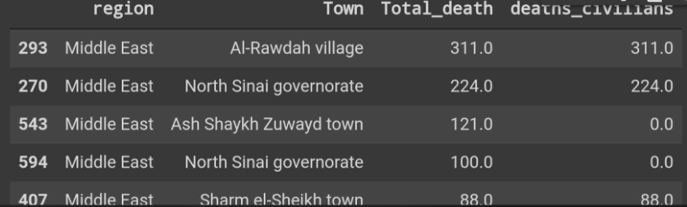
Data Visualization
Title : Conflict_data
Visualization : Top 5 death by town
Collaborator: Lilian
Interpretation: Al-Rawdah had the the highest number of death
Civilian where mostly victims of the conflict in Al-Rawdah
Presenter: Armielyn Obinguar

Slide 23
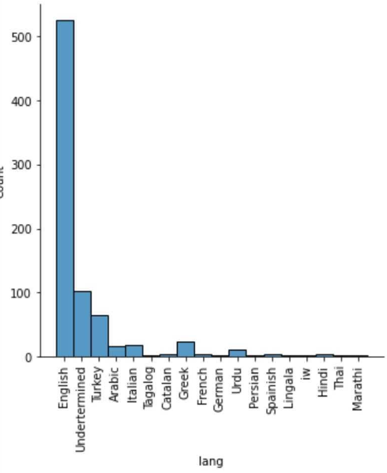
Data Visualization
Title : Economy Tweet
Visualization: Multiple languages used in tweeting about Egypt Economy
Collaborator : Lilian
Interpretation:
English is mostly was used to tweet about Egyptian Economy.
Presenter: Armielyn Obinguar

Slide 24
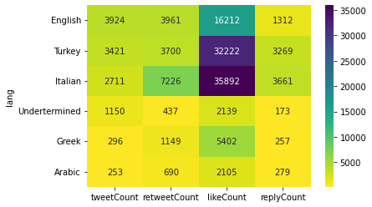
Data Visualization
Title: Covid Tweets
Collaborator: Samuel D. Boadi
Visualization: The top 5 languages used in tweeting about Covid
Interpretation: English had the highest tweet count. Tweets in Italian had the most count in retweets, likes and replies.
Presenter: Armielyn Obinguar

Slide 25
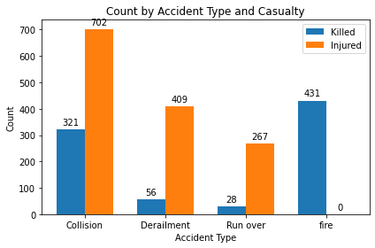
Data Visualization
Title: Train Accident
Collaborator: Samuel D. Boadi
Visualization: Count by accident type based on casualty
Interpretation: The accident type “Collision” had the highest casualty since it most occurring type of accident in Egypt.
Presenter: Armielyn Obinguar

Slide 26
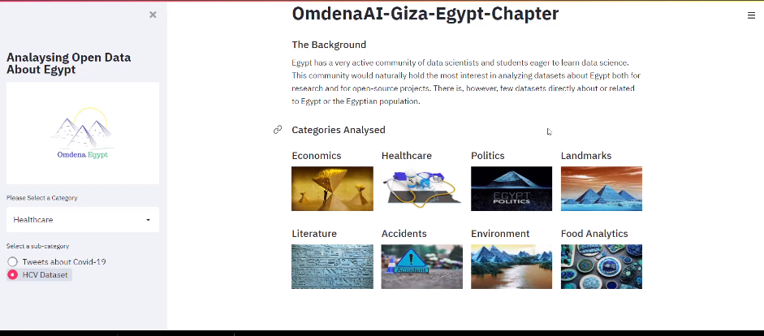
Demonstration
Presenter: Lachin Fernando

Slide 27
Future Scope
Further scraping and data collection can be done on the following category
Health
Food
Economic
Environmental
Financial
Other Categories
Create more datasets in Egypt and visualized
Presenter: Armielyn Obinguar

Slide 28
Collaborators
Abdulaziz Alamri
Ahmed Khaled
Ahmed Samy
Armielyn Obinguar
Hala Jadallah
Hazem Ashraf
Lachin Fernando
Lilian Ugwu
Md Hidayat Rasool
Michael Ghaly
Mohammed El-Srogy
Samuel D. Boadi
Santhosh K
Seif Elfetni
Shivam Negi

Slide 29


